Slide 1

CUSTOMER RETENTION
Balu Gumidelli
This Photo by Unknown Author is licensed under CC BY

Slide 2
SUMMARY:
This study explores the nature of customer relationships in e-retail in India. With the advent of fast and speedy internet services along with smartphone penetration India is in the middle of an e-commerce boom right now with more and more shopping websites and a world to choose from for a regular online shopping customer. In such a scenario it becomes extremely important to understand the nature in which a customer is approaching to this sudden wave of online shopping and accordingly try and customize and build your business so as to differentiate yourself from herd.
The motivation behind this study was to speed up the road to profitability of the horde of
E-commerce websites by a deeper understanding of customers and their patterns while shopping online.

Slide 3
Contents:
Introduction
Problem Statement
Problem Understanding
What is Customer Retention?
Importance of Customer Retention
Exploratory Data Analysis
Visualizations
Conclusion

Slide 4
Introduction
The aim of this study is basically to deal with customer relationships in e-retail in India and how customer retention as a strategy can be looked as a potential untapped marketing management strategy for the internet retailers in India.
With growing Internet penetration and more retailers looking to venture online it becomes necessary to see the possible framework which will increase loyalty ,retain customers and develop relationships beyond pure transactional and financial.
In this presentation we will be looking at the analysis made on the customer retention rate for Indian e-commerce companies.
We will be analysing the customers retention rate and e-commerce success rate with the help of a survey answered by the customers.
This analysis includes the expectations, reliability, trustworthiness etc of the customers.

Slide 5
PROBLEM STATEMENT
Customer satisfaction has emerged as one of the most important factors that guarantee the success of online store; it has been posited as a key stimulant of purchase, repurchase intentions and customer loyalty. A comprehensive review of the literature, theories and models have been carried out to propose the models for customer activation and customer retention. Five major factors that contributed to the success of an e-commerce store have been identified as: service quality, system quality, information quality, trust and net benefit. The research furthermore investigated the factors that influence the online customers repeat purchase intention. The combination of both utilitarian value and hedonistic values are needed to affect the repeat purchase intention (loyalty) positively. The data is collected from the Indian online shoppers. Results indicate the e-retail success factors, which are very much critical for customer satisfaction.

Slide 6
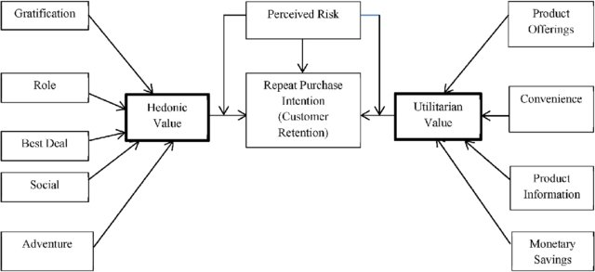
Utilitarian value:
Utilitarian value is an objective value which provides some functional benefits to the consumers and helps consumers to accomplish practical tasks.
Hedonistic value:
Hedonistic value is subjective (Psychological) value which provides an experiential satisfaction. In other words, the immediate psychological gratification that comes from experiencing some activity or from consumption of a product

Slide 7
Problem Understanding :
The problem statement examined how customers form expectations on technology based self-service quality and suggested five main attributes of ecommerce store quality, that are service quality, system quality, information quality, trust and net benefit.
Many businesses focus on customer loyalty programs to remain competitive in today's marketplaces and explore innovative ways to keep their existing customers engaged. Customer retention is a simple concept. Yet, it often requires effort from every department to improve the customer experience and build lasting trust. So, what is customer retention and why it is so important. Let’s know about it by analysing the problem.

Slide 8

What is Customer Retention?
Customer retention refers to the rate at which customers stay with a business in a given period of time. This is often referred to as churn rate and is a key metric for practically all B2B and B2C businesses. In general, the lower the churn, the more loyal the customers and more successful the business, as the business retains more customers over time.

Slide 9
Importance of Customer Retention:
It's also easier and more cost-effective to retain customers than to acquire new ones, returning customers spend more and buy more often, and refer friends and family. Only a 5% increase in customer retention can increase company revenue by 25-95%.
The numbers don't lie: Retaining customers brings companies a ton of ROI.
There are a few reasons why customer retention is critical to company growth and success:
Affordability: It's 6 to 7 times more expensive to acquire a new customer than it is to retain an existing customer.
ROI: A 5% increase in customer retention can increase company revenue by 25-95%.
Loyalty: Retained customers buy more often and spend more than newer customers. They've learned the value of a product or service and keep coming back, again and again.
Referrals: Satisfied, loyal customers are more likely to sing a company's praises and refer their friends and family — bringing in new customers, free of charge.
It might seem obvious — of course, companies should want to retain customers — but when companies start growing quickly and struggle to implement a solid customer support program, proactive customer support for existing customers can slip through the cracks.

Slide 10
Exploratory Data Analysis:
After importing the data set,I’ve checked the shape,value counts,info and null values in the data set.
Then while looking into the value counts I found some duplicate entries in the features i.e., two words with same meaning. I have replaced those duplicates by grouping them.
I ‘ve renamed the columns for better understanding.

Slide 11
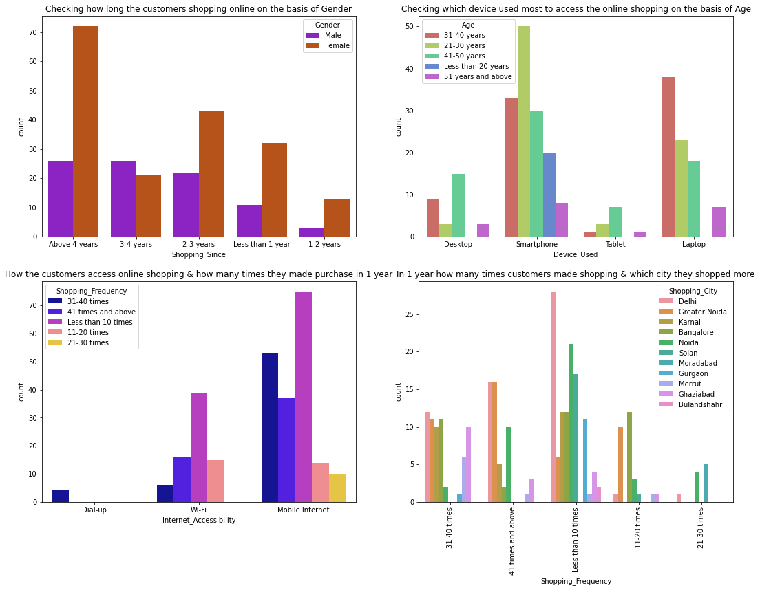
VISUALIZATIONS

Slide 12
Observations:
Most of the female customers shopped online from more than 4 years and the count is also high for the females who shopped from 2-3 years. And only few male customers shop online more than 4 years. Which means the female customers are more enthusiastic to buy products from the online shopping websites.
Many customers whose age between 31-40 years and 21-30 years used Smartphones followed by Laptops to access the online shopping websites.
Most of the customers access the shopping websites more than 31-40 times in 1 year through Mobile Internet to shop the products also most of the customers who used mobile internet to access the online shopping website made online purchase less than 10 times in a year. And only few of the customers used WIFI network to access the shopping store.
Most of the customers used e-commerce websites less than 10 times in a year from the city Delhi to shop the products.

Slide 13
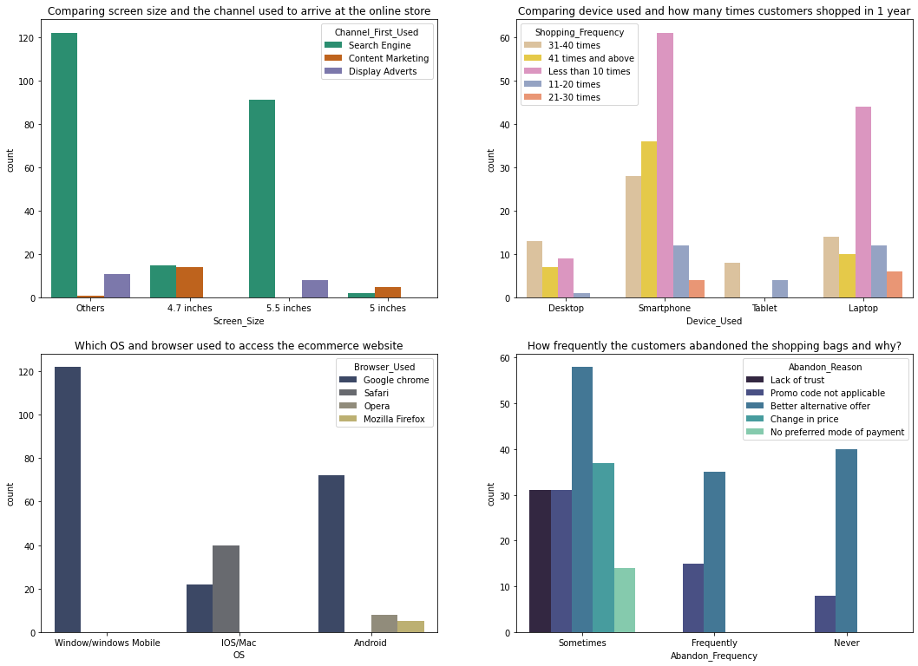

Slide 14
Observations:
The customers having their mobile screen size say 6 inches(others) have followed search engine channel to arrive at their favorite online store for the first time. Also the customers who have their screen size 5.5 inches also used search engine channel to access the online shopping store.
Most of the customers used Smartphones 31-40 times in an year to access the ecommerce websites to shop the products.
Many customers having windows operating system in their device ran Google chrome to access the ecommerce shopping websites and some of the customers having IOS/Mac operating system used Google chrome as well as Safari to reach the online shopping store.
Due to Lack of trust on the ecommerce websites, sometimes most of the customers abandoned the websites and some of the customers abandoned the shopping website due to the promo code not applicable. which means, if the product is having the special price or some catalogue price rule is applicable on it. Then coupon code should not be applicable on the products.
So it is important for the ecommerce companies to create discount price, offers, coupon codes to retain the customers.

Slide 15
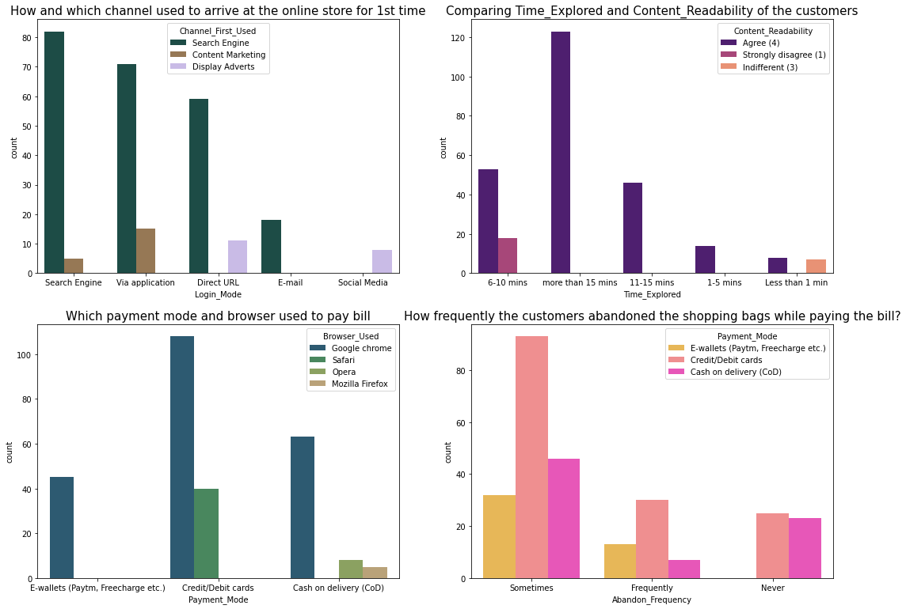

Slide 16
Observations:
Search engine is the most used channel by the customers to arrive their favorite store for the first time and after visit the website for the first time, most of them used the same channel to reach the online retail store to reshopping the products.
Most of the customers agreed that the content on the website is easy to read and understand also they explored more than 15 mins before making the purchase decision and some of the customers strongly disagreed that the content is not good and they explored 6-10 mins before making the purchase decision. So ecommerce websites should enable some images and it should contain clear structure, so that the customers can easily read and understand the content of the product.
Most of the customers used google chrome to reach the websites and they preferred to pay their product price using Credit/Debit cards and only few of the customers used Safari browser to reach the e-retail websites.
Sometimes the customers used to abandon their selected items and wants to leave without making payment and most of them making the payment using E-wallets methods.

Slide 17
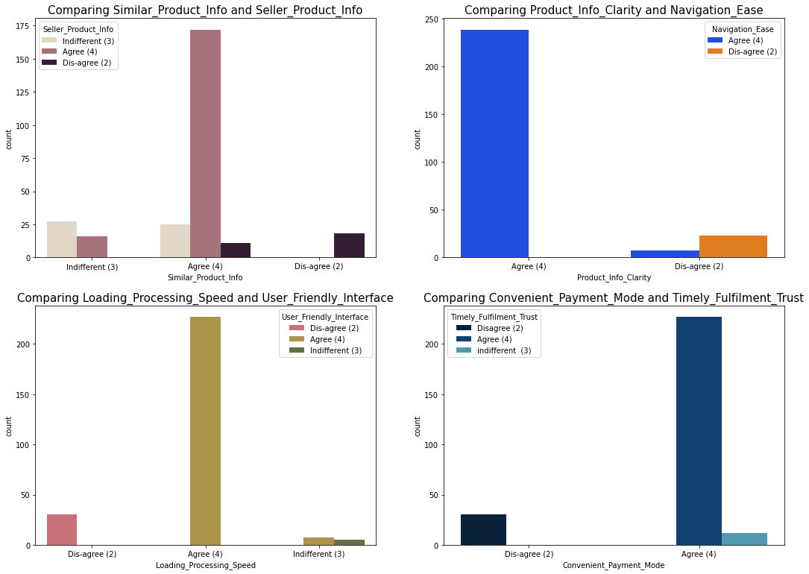

Slide 18
Observations:
Most of the customers agreed that the information on similar product to the one highlighted is important for product comparison and also Complete information on listed seller and product being offered is important for purchase decision. In order to buy a product, the ecommerce website must give the complete information about the product and seller information then only the customers can compare the product costs and its details in different websites and they tend to buy that particular product in a particular website.
Around 90% of the customers agreed that they should be able to navigate the website easily and the products information in the website must be clearly stated their uses, lifetime, benefits etc. Then only more customers tend to buy those products and can shop easily.

Slide 19
Most of the customers agreed with the user friendly interface of the websites which can be easily loaded and processed also these websites' loading and processing capacity is very fast so that the customers like to shop in ecommerce websites. If these websites do not have this much of loading and processing speed then customers don't want to buy the products in this website and they tend to other websites or other options rather than this.
Most of the customers agreed to the trust that the online retail stores will fulfil its part of the transaction at the stipulated time also most of them very happy with the convenient payment modes given by the websites. The websites must provide all the possible ways of payment methods then only the customers shop frequently all the time the mode of the payment for customers may not possible sometimes they may choose cash on delivery. So if the retailers provides all type of payment methods then the customers can easily make the payment also it enhances the sales of the ecommerce sites. And the transaction must also be given with some stipulated time otherwise the payments may be failed so they've to provide minimum amount of time which need to be fixed for all.

Slide 20
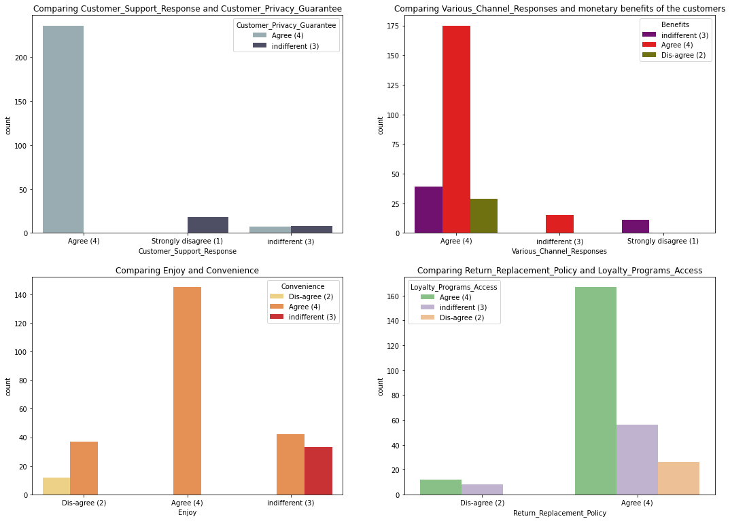

Slide 21
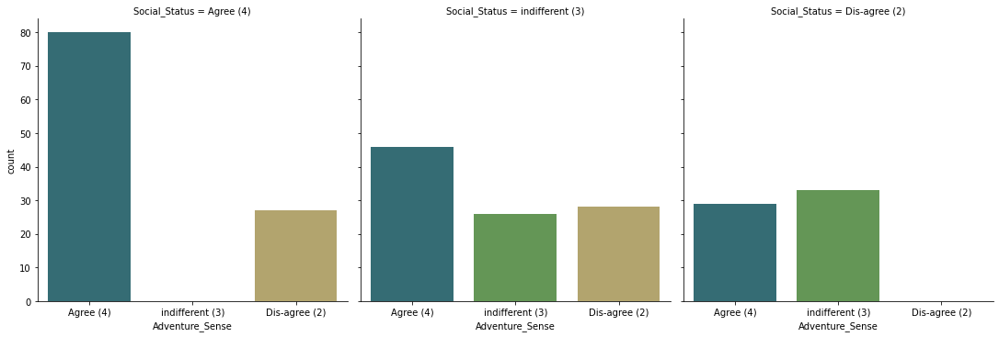
Most of the customers agreed that shopping on the website gives the sense of adventure. The adventures in the shopping websites gives positive activity to experience an amplified enjoyment to the customers while shopping on websites. They also believe that shopping on preferred e-tailer enhances the social status of the customers. Many customers think they are adventuring while shopping online as they search for low cost and high discount products to buy and prefer the same to the others. In this way they think that shopping in the website gives them the adventure.
Shopping online won't affect anyone's status and the customers agreed that shopping on preferred e-tailer enhances their social status.

Slide 22
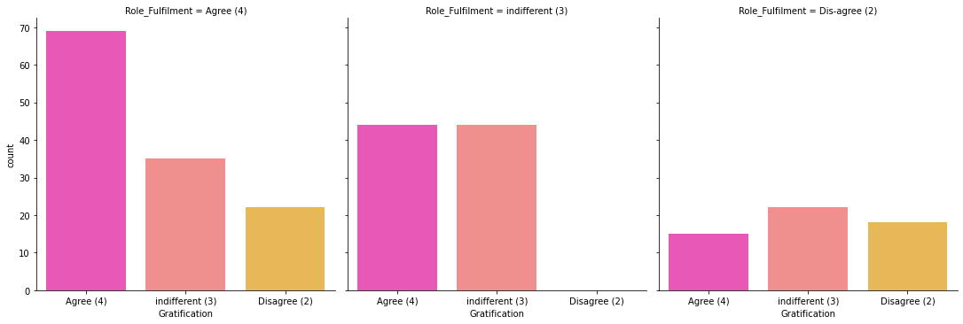
Most of the customers agreed that they felt gratified while shopping on their favorite e-tailer. This is because the e-tailer companies can successfully make up for a mistake or a dissatisfied customer is to be equally expedient in addressing the customer’s needs.
Also, most of the customers agreed that shopping on online website helps them fulfil their certain roles. Fulfilment refers to activities that ensure customers receive what they ordered, including the time of delivery, order accuracy, and delivery condition, also the customers cannot see the product directly before they purchase it. Companies must ensure delivery timeliness, order accuracy, and delivery conditions to provide superior service quality for customers. The companies must understand that the customer satisfaction is an indication of the customer's belief of the probability of a service leading to a positive feeling. If the companies give positive vibration to the customers by giving chance to fulfil their roles then they shop more on that particular website.

Slide 23
CONCLUSION:
High customer retention:
Amazon.in
Flipkart.com
High risk of customer churn with:
Myntra.com
Snapdeal.com
Paytm.com

Slide 24
THANK YOU

